Slide 1
Desoutter Industrial Tools Process Control - Installation
Burton On Trent, UK – 01.09.2016

Slide 2
Revision History
Revision | Date | Comments | Author
1.0 | 01.09.16 | Initial revision | A. Pain
2.0 | 13.10.2016 | Add Infinity station update + Core service configuration + modules | X. Richard

Slide 3




Process Control Installation
In the following presentation we will cover how to install all required software on a customer site to create a full process control installation. These include:
FusionCORE Database
Desoutter CORE Services
CVI Fusion
Infinity Client Devices
CORE SERVICES

Slide 4
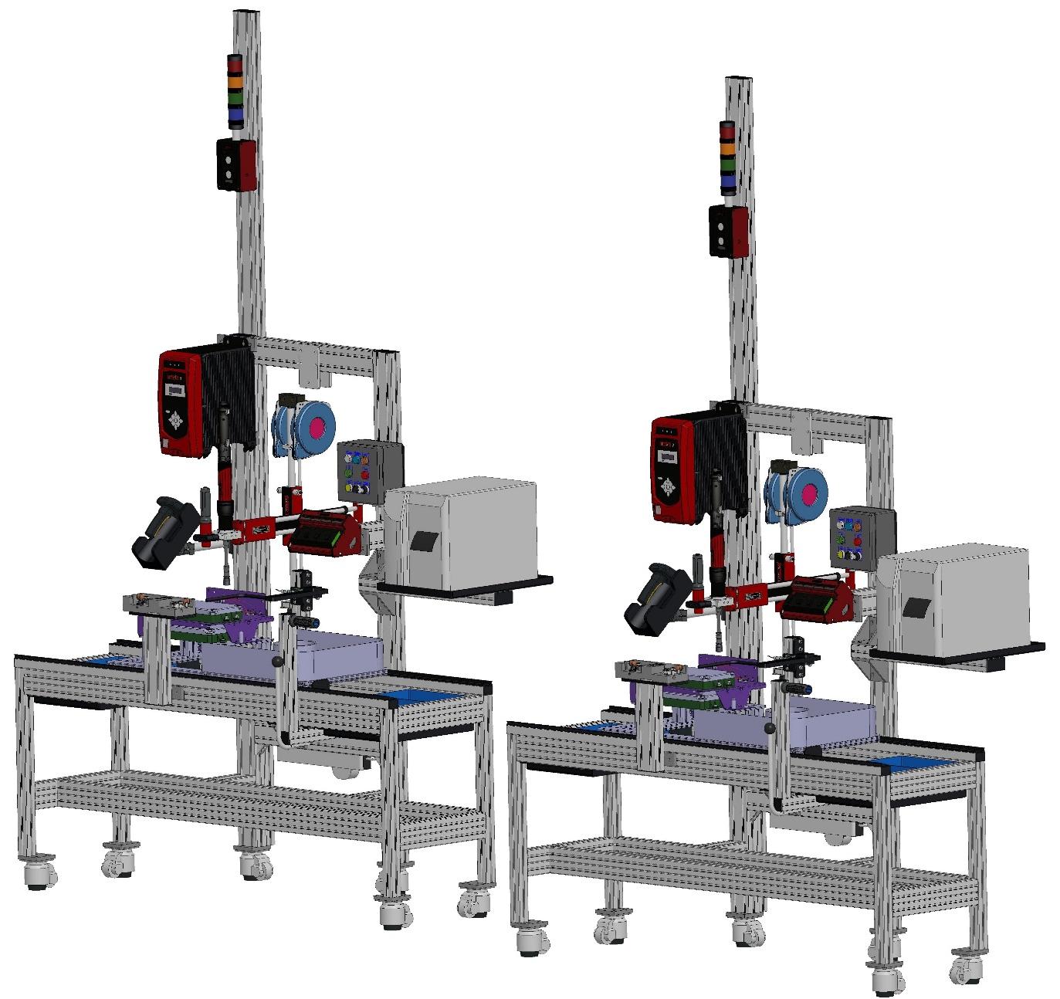
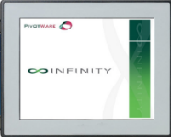


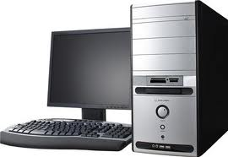

INFINITY Stations
Operator guidance
Information display
Process management
Connected through Ethernet network
(wifi option is available)
Communication with tools using Open Protocol
Communication with third part device using serial link (ASCII protocols)
INFINITY Module - Tracker
Allow to start process on
station 2 only if station 1 is ok
Exchange data between station 1 and 2
(ex: final torque value)
Connected to the stations through
ethernet network
(wifi option is available)
INFINITY Module - Builder
Receive the production data (VIN)
Send production tickets
to the INFINITY stations
Connected to the stations through
ethernet network
(wifi option is available)
Process flow
INFINITY Configurator
INFINITY stations setup
Results Viewer (additionnal license)
Connected to the stations through
ethernet network
INFINITY Core Service and database
Save the stations results
(all process steps)
Connected to SQL Server database
Station 2
Station 1

Slide 5
Station 2
Station 1
INFINITY Module - Tracker
Allow to start process on
station 2 only if station 1 is ok
Exchange data between station 1 and 2
(ex: final torque value)
Connected to the stations through
ethernet network
(wifi option is available)
INFINITY Module - Builder
Receive the production data (VIN)
Send production tickets
to the INFINITY stations
Connected to the stations through
ethernet network
(wifi option is available)
INFINITY Stations
Operator guidance
Information display
Process management
Connected through Ethernet network
(wifi option is available)
Communication with tools using Open Protocol
Communication with third part device using serial link (ASCII protocols)
INFINITY Configurator
INFINITY stations setup
Results Viewer (additionnal license)
Connected to the stations through
ethernet network
INFINITY Core Service
Save the stations results
(all process steps)
Connected to SQL Server database

Slide 6
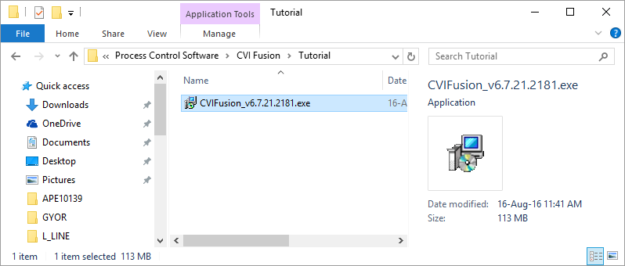
1 - Process Control Installation – CVI Fusion
Locate your CVIFusion installer. It will be a .exe file. This file will run a standard Windows Installer making it easy to install CVI Fusion
Double-click the installer to run it

Slide 7
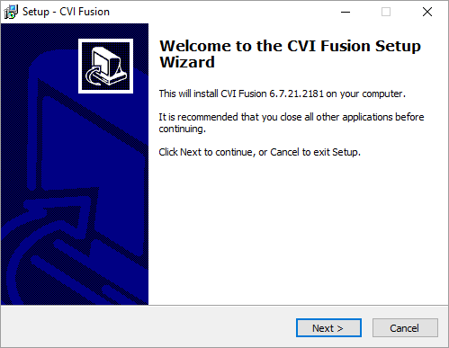
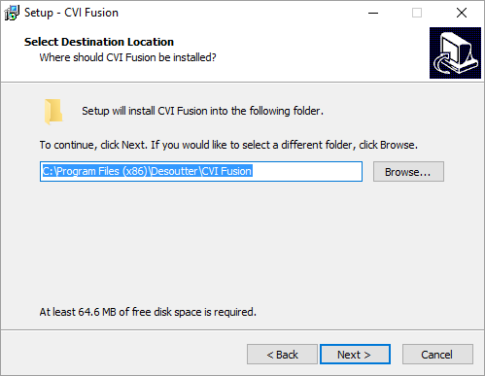
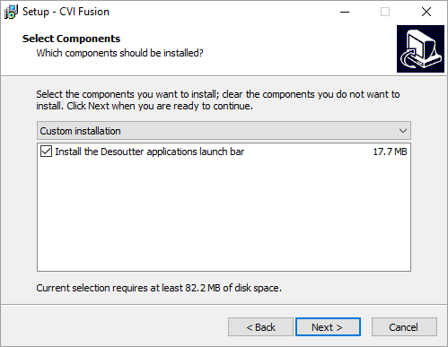
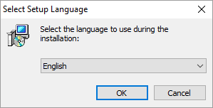
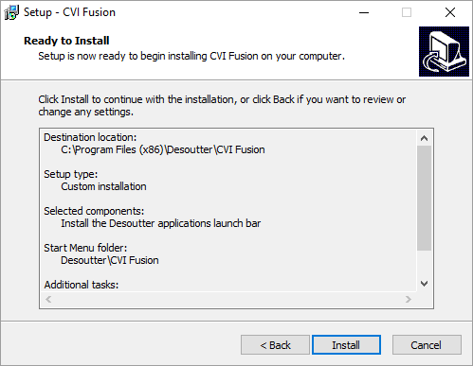
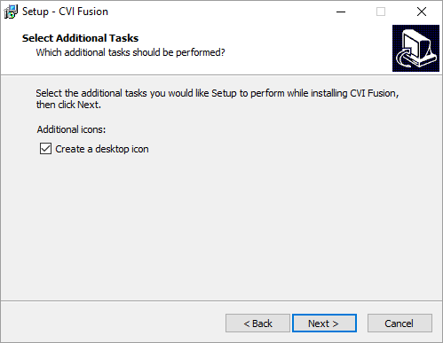
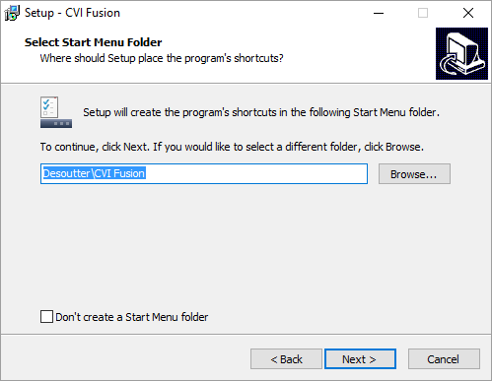
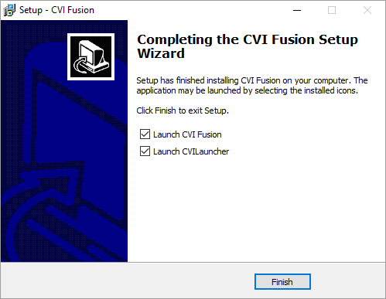
1 - Process Control Installation – CVI Fusion
Follow the instructions in the installer to install CVI Fusion

Slide 8
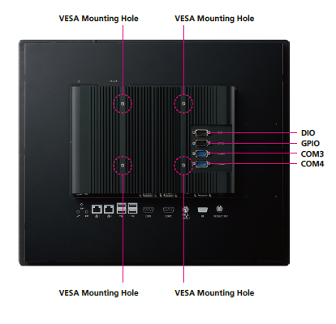
2 - Process Control Installation – Infinity Client
Infinity 17” PPC are pre-installed with Infinity Client software meaning there is no set-up required.
For hardware however they require a mounting in order to be usable on a production floor; see here for details:
Mounting Dimensions (mm):
100 x 100

Slide 9
2 - Process Control Installation – Infinity Client
In case of Fusion upgrade we have to upgrade the version of Infinity client
To upgrade it, you have to replace the folder Pivotware located in C: by the new Pivotware folder provided in a .zip file

Slide 10
2 - Process Control Installation – Infinity Modules
In case of Fusion upgrade we have to upgrade the version of Infinity modules (Builder and Tracker)
To upgrade it, you have to replace the folder Pivotware located in C: by the new Pivotware folder provided in a .zip file
Same .zip file is used to upgrade Infinity module Tracker and Builder. The differenciation is done in the configuration dent by the Fusion software

Slide 11
3 - Process Control Installation – FusionCORE Database
The FusionCORE database is a standard Microsoft SQL database created using a SQL Query.
A SQL Query is a set of instructions executed by Microsoft SQL Server in order to return specific values in a database or to action a task.
To create the database we simply open the Microsoft SQL Server.
Using the standard menus we create a new database.
We run our SQL query with our FusionCORE Database as the target
for the query.
We’ll go through this step-by-step…

Slide 12

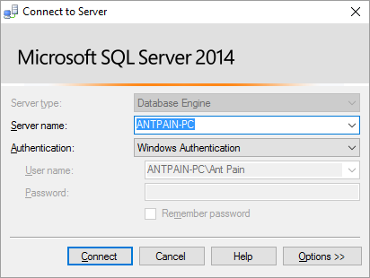
3 - Process Control Installation – FusionCORE Database
Open ‘Microsoft SQL Server Management Studio 2014’

Slide 13
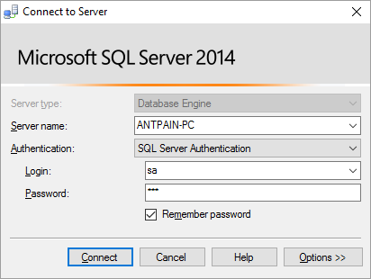
3 - Process Control Installation – FusionCORE Database
Connect to the SQL Server using the ‘sa’ account if possible.
If the ‘sa’ account is not available for any reason use the account with the most permissions possible.
‘sa’ account is the ‘system administrator’

Slide 14
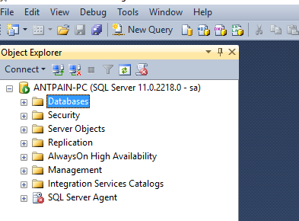
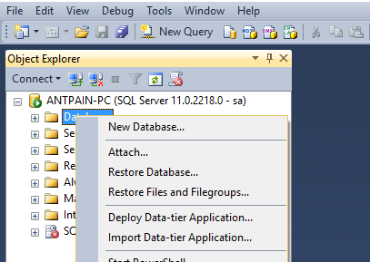
3 - Process Control Installation – FusionCORE Database
Once you are logged in, right-click on ‘Databases’ and choose ‘ New Database…’
This menu you are viewing is the Object Explorer – it is a navigation menu where you can access all area of your database and all components that can integrate with it.

Slide 15
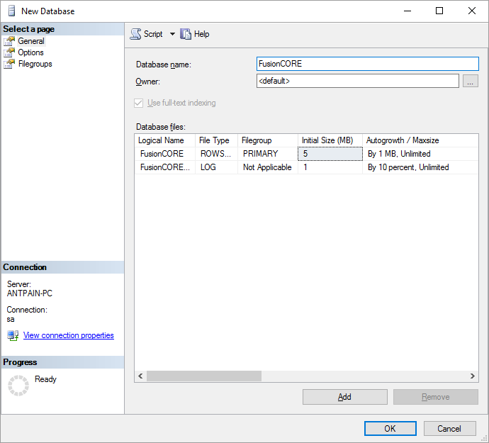
3 - Process Control Installation – FusionCORE Database
You will see this window after clicking ‘New Database…’
Give your database a name – the standard is ‘FusionCORE’ - and click ‘OK’
Leave all other settings as default otherwise you risk changing settings which can alter how your database will run.

Slide 16
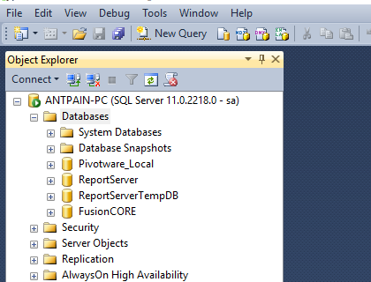
3 - Process Control Installation – FusionCORE Database
You should automatically see your database now in the ‘Object Explorer’ if you expand the ‘Databases’ category

Slide 17
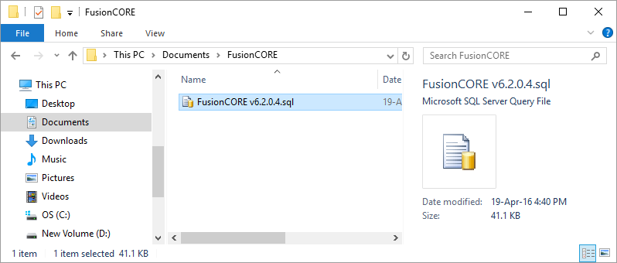
3 - Process Control Installation – FusionCORE Database
Locate your Database Creation Script. It will be a .sql file. This file will give SQL Server instructions on how to create the correct layour for the database.
Double-click this file to open it inside of SQL Server Management Studio 2014

Slide 18
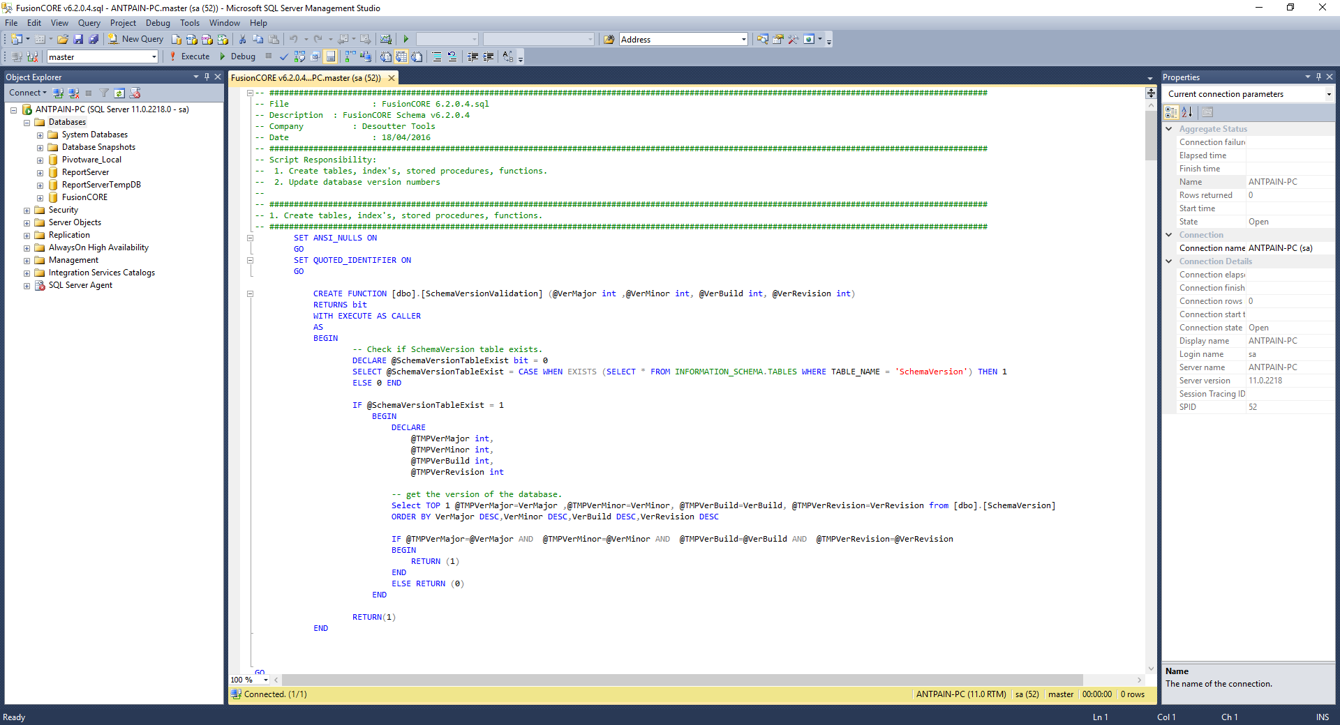
3 - Process Control Installation – FusionCORE Database
The query will open in the main window – you do not need to alter ANTHING in the query

Slide 19
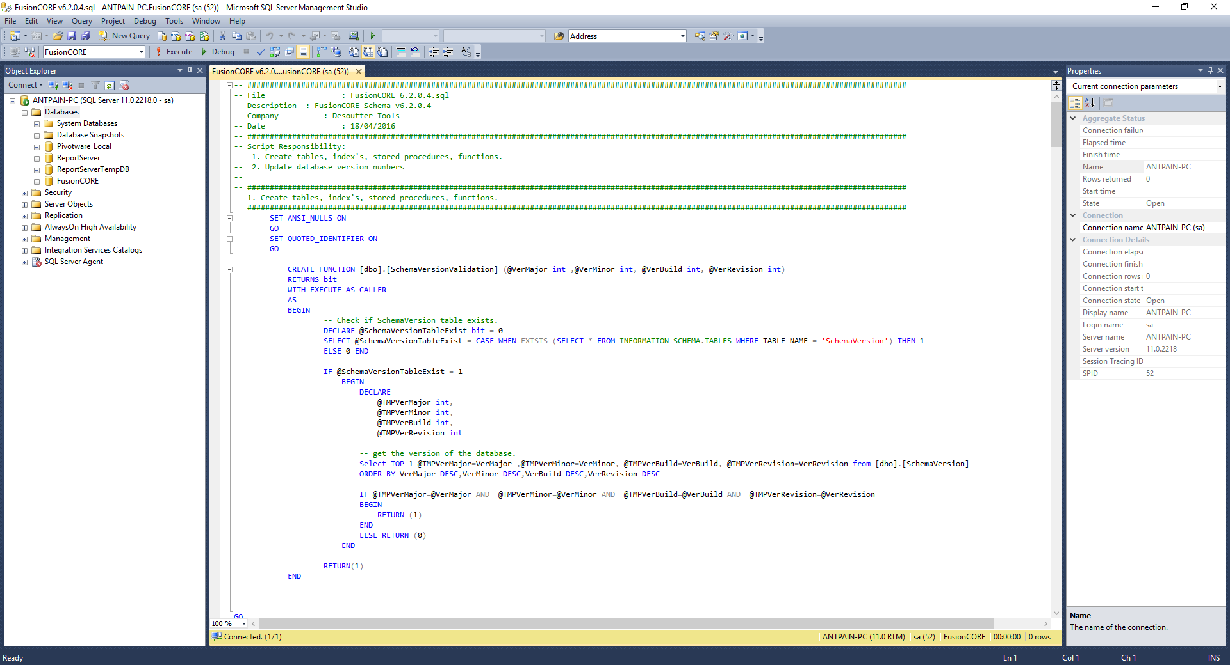
3 - Process Control Installation – FusionCORE Database
Ensure that the database being targeted for the query is ‘FusionCORE’

Slide 20
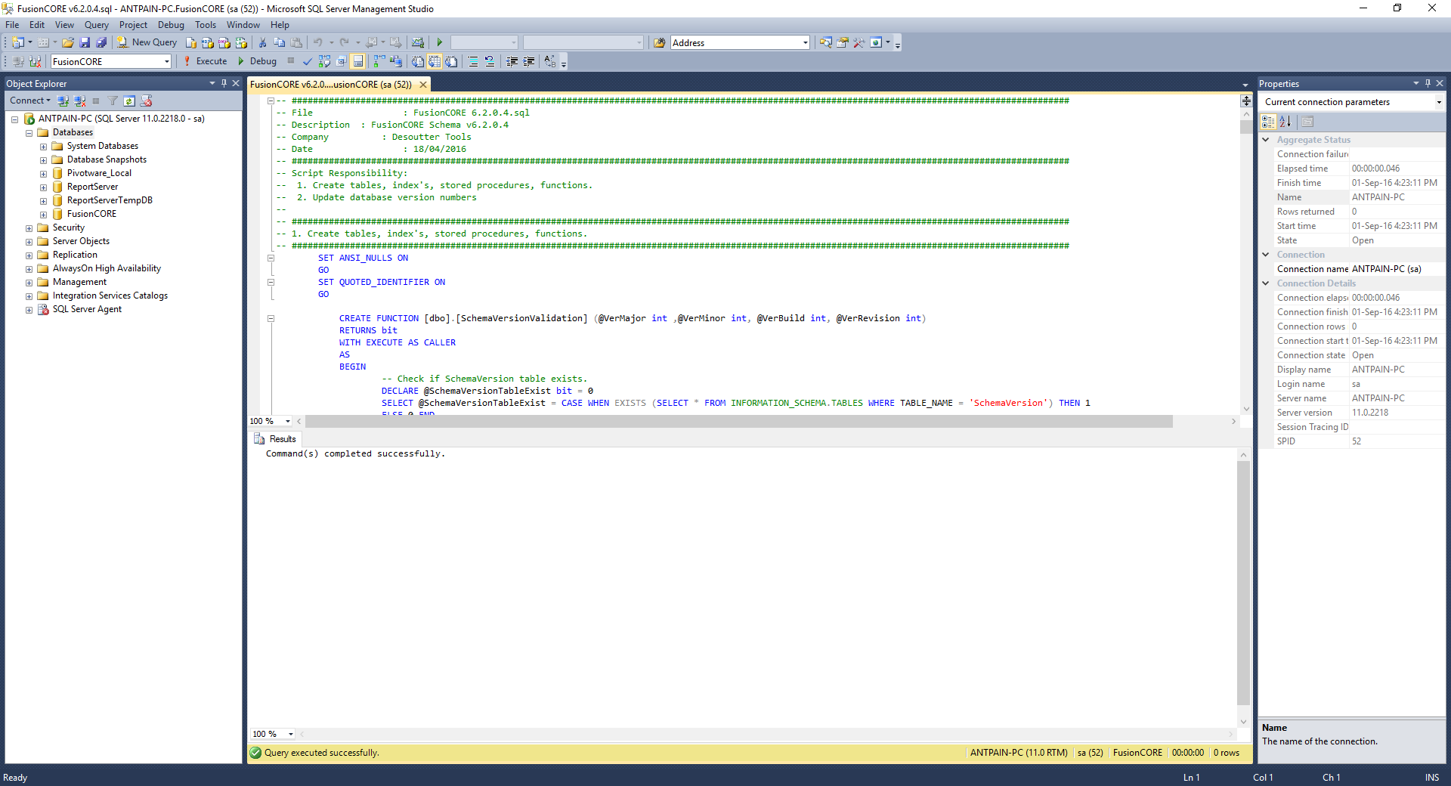
3 - Process Control Installation – FusionCORE Database
Click the ‘Parse’ button to ensure the query has no errors

Slide 21
3 - Process Control Installation – FusionCORE Database
Click the ‘Execute’ button to execute the query.

Slide 22
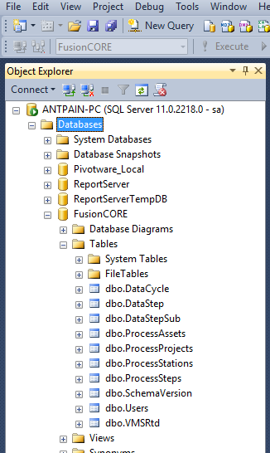
3 - Process Control Installation – FusionCORE Database
If you look in the ‘Object Explorer’ and expand as follows:
Databases >> FusionCORE >> Tables
You will see that all your tables have been created.
CVI Fusion will write process information to these tables.
CVI Fusion will read traceability from these tables.
Desoutter CORE Services will read from these tables.
Desoutter CORE Services will write tracebility to these tables.

Slide 23
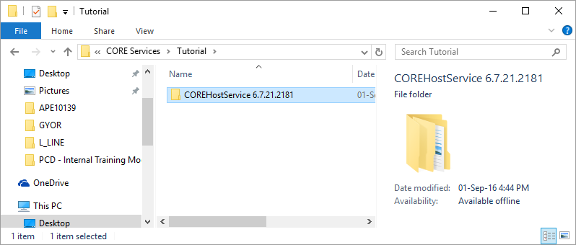
4 - Process Control Installation – CORE Services
Locate the folder for the ‘Core.Host.Service’

Slide 24
4 - Process Control Installation – CORE Services
Copy this folder on to a server. This server must be active at all times and have network access to both the database and the Infinity devices.
Copy it into the folder: C:\Program Files (x86)\Desoutter

Slide 25
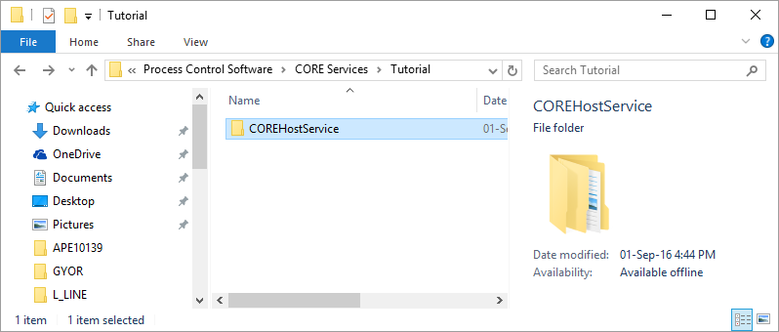
4 - Process Control Installation – CORE Services
Once it has been copied to the server; remove the version number and go into the folder

Slide 26
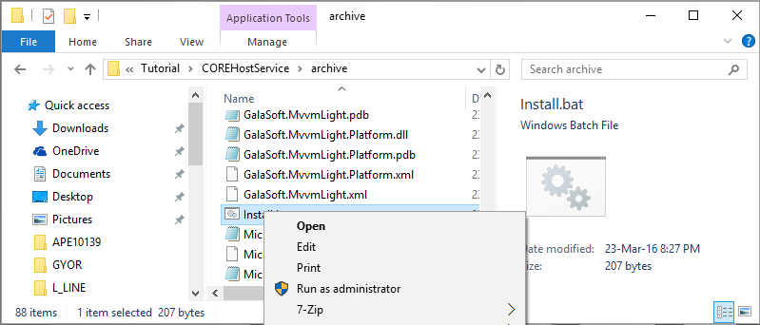
4 - Process Control Installation – CORE Services
Locate the file named ‘Install.bat’
Right-click and choose ‘Run As Administrator’

Slide 27
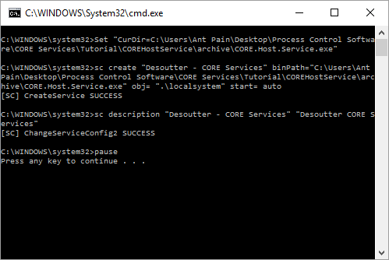
4 - Process Control Installation – CORE Services
You will see a console window appear notifying you that the service has been created successfully or has failed

Slide 28
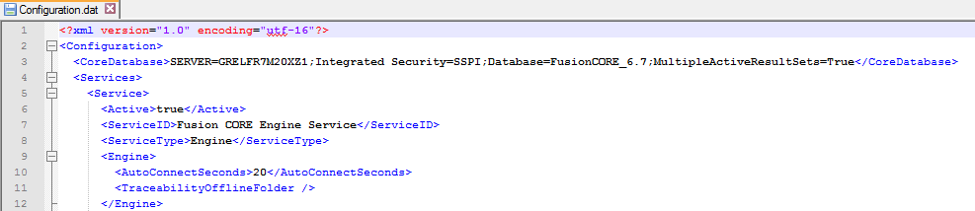
4 - Process Control Installation – CORE Services
Edit the file Configuration.dat in order to set the database server, name and connection informations.
You can use a Windows or SQLServer authentication mode to connect to the database

Slide 29
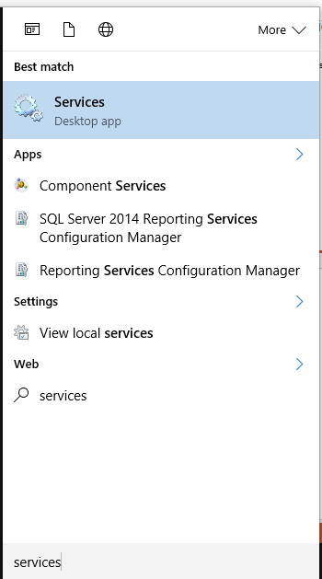
4 - Process Control Installation – CORE Services
Open the ‘Start Menu’ and type in ‘Services’
Open this menu
Start Menu may differ in appearance to your machine

Slide 30
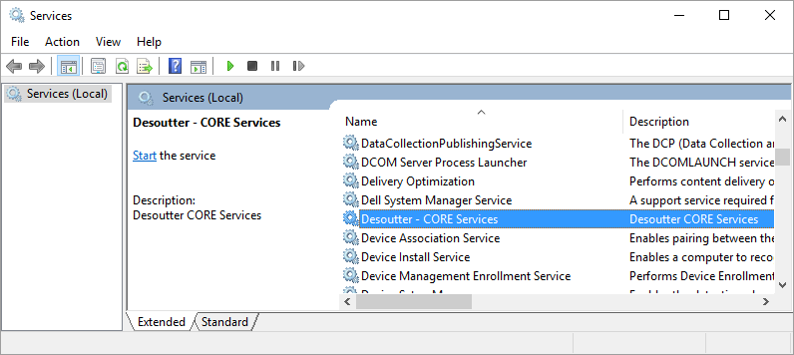
4 - Process Control Installation – CORE Services
Locate the service named ‘Desoutter – CORE Services’
Click ‘Start the Service’

Slide 31
5 - Upgrades
If you upgrade the Fusion software version, you have to upgrade :
Infinity client and modules stations
Core service
Database structure (using a .sql file)

Slide 32

Any Questions?
Notes:
Will be covered in more detail later in the training with official documentation

